Slide 1
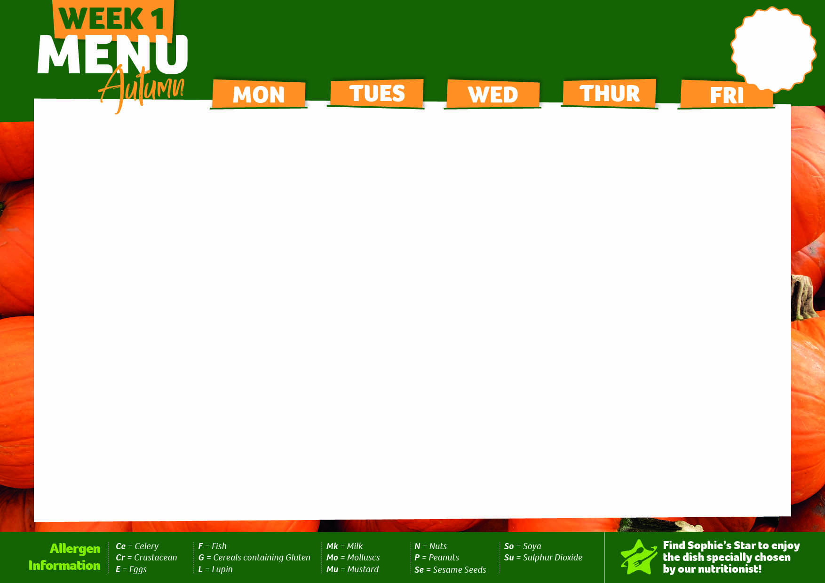


01/09/25, 22/09/25, 13/10/25, 17/11/25, 08/12/25
Logo
Mighty Mains | Lamb Kofta Curry (Chickpeas,So) | Roasted Chicken With Fire Roasted Pepper, Spinach Tomato Sauce & Gnocchi (G,So,Mu,Mk,E) | Cottage Pie with Creamy Mash & Gravy (Mk) | Sticky Teriyaki Pork (G,So) Prawn Crackers(Cr,Su) | Crispy Chicken Goujons, BBQ Sauce (G)
Made With Ingredients Not Containing Gluten | Lamb Kofta Curry with Steamed Rice (Chickpeas,So) | Roasted Chicken, With Fire Roasted Pepper, Spinach Tomato Sauce & Gluten Free Pasta (None) | Cottage Pie with Creamy Mash & Gravy (Mk) | Sticky Teriyaki Pork with Egg Fried Rice (E,So) | Chicken Goujons, BBQ Sauce (E)
Super Veggie Mains | VEGAN Mild Caribbean Coconut Sweet Potato & Vegetable Curry (None) | VEGAN Plant Based Red Lentil & Aubergine Moussaka (G,So) | VEGAN Plant Based Mince & Autumn Vegetable Shepherd’s Pie, Topped with Parsnip and Sweet Potato Mash (G,So,Ce) | Korean Tofu & Mushroom Sriracha Stir-Fry (G,So,Mu) | Roasted Pepper, Spinach & Cheddar Cheese Wholemeal Quiche (G,E,Mk)
Garden Goodness Sides | Corn on the Cob Steamed Carrots | Rocket and Radish Salad Sautéed Savoy Cabbage | Sweetcorn with Roasted Peppers Steamed Green Beans | Pickled Vegetables Broccoli | Spring Onion Slaw (E) Baked Beans
Energy Boosters | Steamed Rice Mini Naan Bread (G) Raita (Mk,So) | Home Made Garlic Bread (G,Mk) | Wholemeal Seeded Bread (G) | Egg Fried Rice (G,E,So) | Chips
Pudding | Seeded Frosted Carrot Cake (G,E,Mk) | Seasonal Autumn Hero - Apples - Dutch Apple Cake (G,E,Mk) with Custard (Mk) | Rocky Road (G,Mk,So) | Classic Jam Sponge(G,E) With Custard (Mk) | Chocolate Marble Cake (G, E)
Jacket Potatoes, Pasta, Cold Desserts & Fruit Platter available daily

Slide 2

08/09/25, 29/09/25, 03/11/25, 24/11/25
Logo
Mighty Mains | Succulent Yoghurt Marinated Tandoori Chicken with Cucumber, Mint & Red Onion Salad (So,Mk) | Traditional Slow Cooked Beef Bolognaise with Pasta (G) | Mexican Lamb Chilli with Red Onion and Tomato Salsa with a Soft Tortilla (G) | Pork Meatballs in a rich Tomato Sauce with Pasta (G,Su) Topped with Parmesan & Green Pesto (Mk) | BBQ Chicken & Cheese Panini (G,Mk,So,Su,Mu)
Made With Ingredients Not Containing Gluten | Succulent Yoghurt Marinated Tandoori Chicken with Cucumber, Mint & Red Onion Salad (So,Mk) | Traditional Slow Cooked Beef Bolognaise with Gluten Free Pasta (None) | Mexican Lamb Chilli with Red Onion and Tomato Salsa with White & Wholegrain Rice (None) | Pork Meatballs in a rich Tomato Sauce with Gluten Free Pasta (Su) | BBQ Chicken & Cheese Panini (Mk,So,Mu)
Super Veggie Mains | VEGAN Tandoori Cauliflower with Tarka Dhal (G,Ce) | VEGAN Lentil Bolognaise (G,Ce) | VEGAN Red and Black Bean Eat Curious Chilli with Red Onion and Tomato Salsa with a Soft Tortilla (G) | Oven Baked Spinach & Ricotta Cannelloni (G,E,Mk,Mu,So) | Pesto, Tomato & Cheese Panini (G,Mk,So,Su,Mu)
Garden Goodness Sides | Roasted Sweetcorn Sautéed leeks | Steamed Broccoli Accent House Salad (Su,Mu) | Steamed Green Beans Thyme Roasted Carrot and Beetroot | Baked Courgettes with Lemon & Garlic Tomato & Rocket Salad (Su) | Caeser Salad (G,E,Mk,So) Baked Beans
Energy Boosters | Steamed Cardamom Rice Mild Curry Sauce Mini Naan Bread (G) Raita (Mk,So) | Garlic Focaccia (G) | White and Wholegrain Rice | Home Made Garlic Bread (G,Mk) | Oven Baked Potato Wedges
Pudding | Accent Signature Seeded Flap Jack (G,Su) | Vanilla and Black Cherry Sponge & Custard Sauce (G,E,Mk,So) | Gooey Chocolate Brownie (G,E) | Sticky Toffee Pudding with Toffee Custard (G,E,Mk) | Ice Cream (Mk)
Jacket Potatoes, Pasta, Cold Desserts & Fruit Platter available daily

Slide 3

15/09/25, 06/10/25, 10/11/25, 01/12/25
Logo
Mighty Mains | Chicken Katsu Curry (G,So) | Cumberland Sausages with Gravy (G,Su) Caramelised Balsamic onion Chutney (Su,Mu) | Traditional Slow Cooked Italian Beef Tomato Lasagne (G,E,Mk) | Roast Of the Week & Gravy Homemade Stuffing (G,E,Mk,So) Yorkshire Pudding (G,E,Mk) | Battered Fish/Fish Fingers (G,F) Chunky Tartare Sauce (E) & Lemon Wedges Oven Baked Salmon & Broccoli Frittata (Mk,F,E) R06736
Made With Ingredients Not Containing Gluten | Chicken Katsu Curry (E,So) | Gluten Free Sausages with Gravy (Su) | Traditional Slow Cooked Italian Beef Tomato Gluten Free Lasagne (Mk,So) | Roast Of the Week, Gravy & Thyme Roast Baby Potatoes (None) | Gluten Free Fish with Chips (F)
Super Veggie Mains | Tofu Katsu Curry (G,E,So) | VEGAN Plant Based Sausages with Gravy (G) Caramelised Balsamic Onion Chutney (Su,Mu) | Mediterranean Roasted Vegetable Lasagne (G,E,Mk) | Seasonal Autumn Hero – Squash Accent Signature “Squashage” Roll (G,E,Mk) with Herby Gravy | VEGAN Home- made Fishless Fingers, with Vegan Mayonnaise & Lemon (G,So)
Garden Goodness Sides | Steamed Cauliflower Five Spiced Corn Cob | Baked Beans Honey Roasted Parsnip | Steamed Broccoli Accent House Salad (Su,Mu) | Sauté Savoy Cabbage Steamed Carrots | Garden Peas Baked Beans
Energy Boosters | Steamed Rice | Crushed Potato with Spring Onion | Garlic Focaccia (G) | Thyme Roast Baby Potatoes | Chips
Pudding | Lemon & Lime Drizzle Cake (G.E) | Rice Krispie Cake (G) | Blueberry & Courgette Cake (G,E) | Banana Cake with Toffee Drizzle (G,E,Mk) | Chocolate Chip Cookie (G,Mk,So)
Oven Baked Salmon
& Broccoli Frittata
(F,MK,E)
Jacket Potatoes, Pasta, Cold Desserts & Fruit Platter available daily

